Slide 1
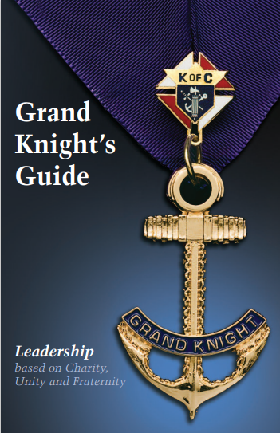





1st Priorities
Next Priorities
Successful Meetings
Youth Protection
This symbol will help provide tips and guidance..
Training
Workshop
2021
Go in document section
Go to WEB Link
Return to home page

Slide 2
1. First Priorities
Becoming a Grand Knight can be overwhelming. Focus on these 9 items first before you worry about everything else.
Surround yourself with great leaders
Insist your predecessor brings you up-to-speed
Get basic training
Create a working relationship with your Pastor
Run effective council & officer meetings
Establish goals for the council and it’s members
Understand, embrace and implement Faith in Action
Focus on addressing your council’s biggest issues
Use the State Council’s e-mail system
Notes:
Audio Overview
These 9 things should be your main focus as you begin
Have these done by end of September (Q1)
These are the most important things to get you started
If you handle these first, the rest is much easier
If you miss 1 or more of these, your job gets a lot harder

Slide 3
1.1 Surround yourself with great leaders
Duties Responsibilities Council Officers Directors
Chaplin
(Name)
Grand Knight
(Name)
Elected
Appointed
Deputy GK
(Name)
Treasurer
(Name)
Program Dir
(Name)
Membership Dir (Name)
Chancellor
(Name)
Trustees
1 (name)
2(Name)
3(Name)
Family Dir
(Name)
Retention Chair (Name)
Warden
(Name)
Community Dir
(Name)
Retention Committee
1 (name)
2(Name)
3(Name)
Fin. Secretary
(Name)
Outside Guard
(Name)
Life Director
(Name)
Recorder
(Name)
Inside Guard
(Name)
Faith Director
(Name)
Ins. Promotion
(Name)
Lecturer
(Name)
Advocate
(Name)
Vocations Chair (Name)
Health Services (Name)
Public Relations
(Name)
3

Slide 4

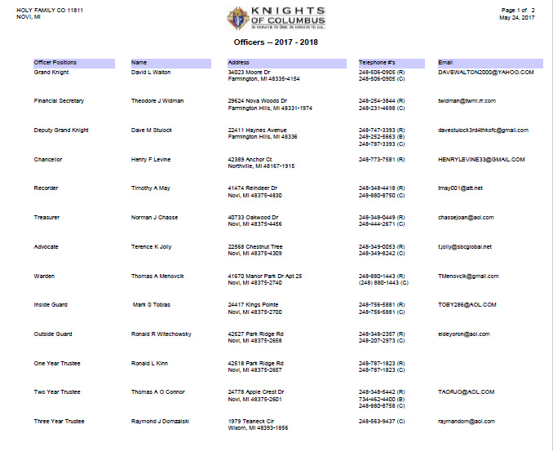
Report of Officers Chosen for Term (Form 185)
Member Management Steps
Go to: www.kofc.org (click)
Sign in
Officers Online
Member Management
LIVE
Council Administration
Council Officers
  Choose Role
  Assign a Name
Submit
Print Center
Save & e-mail report
Another Option is to submit the PDF form 185
Report of Officers Chosen for the Term #185
Report of Officers Chosen - Instructions
Watch this 5-minute YouTube video to see how to submit form 185 using Member Management

Slide 5
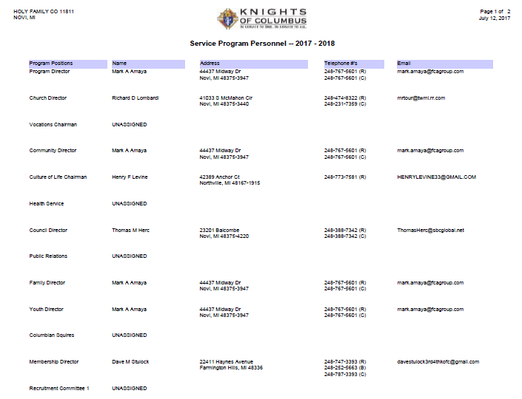
Service Program Personnel Report (Form 365)
Member Management
Go to: www.kofc.org (click)
Sign in
Officers Online
Member Management
LIVE
Council Administration
Service Program Personnel
  Choose Role
  Assign a Name
Submit
Print Center
Save & e-mail report
Another Option is to submit the PDF form 365
Service Program Personnel Report #365
Service Program Personnel Report - Instructions
Watch this 5-minute YouTube video to see how to submit form 365 using Member Management

Slide 6


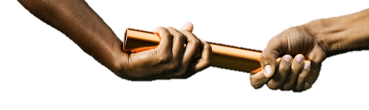
1.2 – Have your predecessor bring you up to speed
Forms submitted the previous 2 years
  Gmail Account Training video
GK Jewel
Lessons Learned
Important Issues facing the council
Your GKXXXX@mikofc.org account has a space on the google drive that you can store forms and documents. When you use the drive and hand off email and password it will allow the new GK to have the items he needs to take over smoothly..

Slide 7
1.3 Get Basic Training
There are 9 links on this page. If you spend 10 minutes looking at each link, you’ll be done in 90 minutes. It’s well worth the time.
Supreme Website – Navigating Supreme Website
  Training & Webinars
  Video Library
State Website – Navigating the Michigan State KofC Website
  Resources = Programs, Membership, Forms, Training & Documentation
Required Technology
  Gmail Account Training video
  Youth Protection Training video
  Officers Online Overview video
Meetings
  District Meetings (Held 2+ times / year)
  Diocesan Meetings (Held 1+ times / year)
Leadership Guide – 2020-2021 Leadership Guide

Slide 8
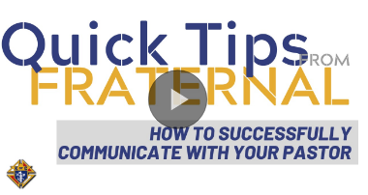
1.4 Relationship with your Pastor(s)
Set up a meeting to get to know each other.
What does he want/need from the Knights?
  How can you help?
Does he have issues with the Knights?
Become the council he wants you to be.
Meet regularly to stay aligned (quarterly)

Slide 9
1.6 – Establish “Realistic” Council Goals
Inputs
Outputs
Goals should be > last year
Get Directors to own their goals
Document your goals
Share them with your Council
Review them (quarterly)
Make adjustments when necessary
Have an “Action Plan”
  Step-By-Step
  Timeline
  Who’s doing what & when?
Last Year Results
Program Plans
State Goals
Planning with Officers & Directors
Membership Plans
District Goals
Parish Goals
Insurance Plans
Council Goals
Financial Plans

Slide 10
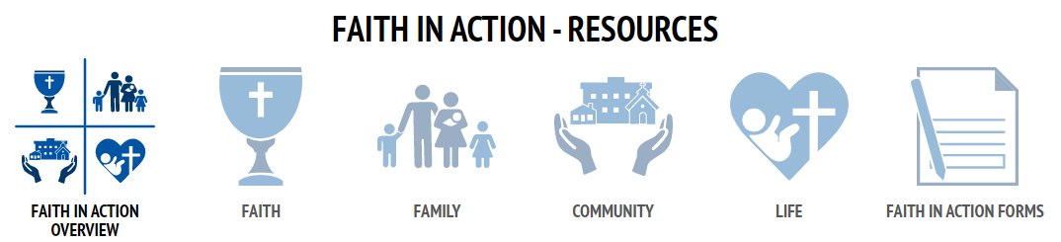
1.7 Faith in Action
Each program listed on the Supreme website contains:
Guide Sheets (How to run the program)
Posters (Advertisement)
Brochures (Advertisement)
Other materials
Get Educated – including your Program Director(s)
    Supreme Faith In Action website
Talk to your Pastor
Choose Activities
  Plan them
  Do them

Slide 11
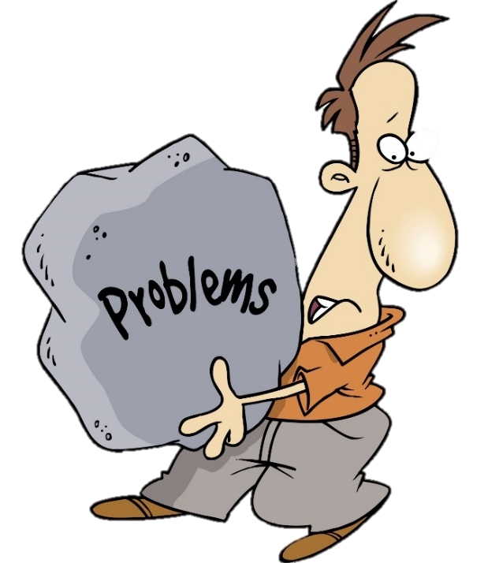
1.8 Address Problems
Seek out the Critical Issues
Prioritize them (with your Officers & Directors)
Step up and fix the biggest issues
Things to consider
  Focus on the “few” most important
  Delegate some (Give your leaders a chance to shine)
  Ask your District Deputy for help
Bad news does NOT get better with time. In fact, it typically gets much worse. So, work on your issues sooner rather than later.

Slide 12
2. Next Priorities
When you’ve mastered the top 9 priorities (first section), then, and only then, start to address these items.
Star Council Award
Forms – Communicate to Supreme & State
Mentor and develop your leaders
Notes:
Audio Overview
These 9 things should be your main focus as you begin
Have these done by end of September (Q1)
These are the most important things to get you started
If you handle these first, the rest is much easier
If you miss 1 or more of these, your job gets a lot harder

Slide 13
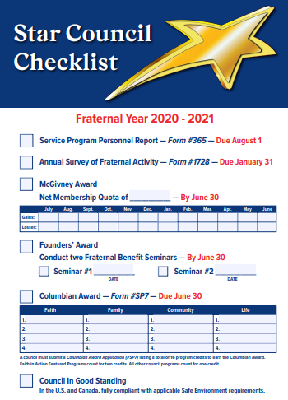
2.1 Star Council
Attain Membership Goals
Attain Insurance Goals
Attain Program Goals
Submit Required Forms
    Annual Survey of Fraternal Activity - PDF - Online
    Report of Officers Chosen for Term - PDF - Online
    Service Program Personnel Report - PDF - Online
    Columbian Award Application - PDF - Online - Instructions
  Make all per-capita payments
  Complete Youth Protection Training

Slide 14
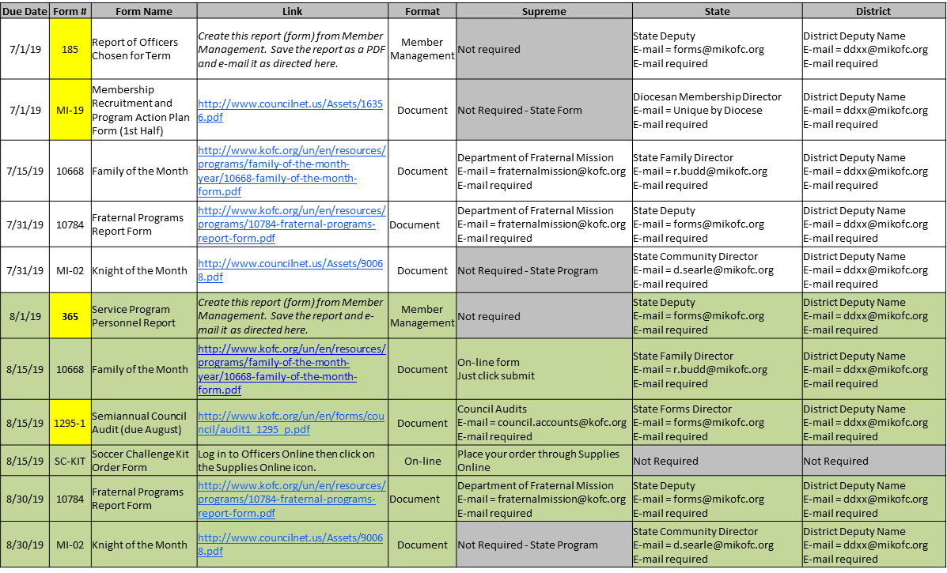
2.2 Forms
Watch the Forms Overview Video
Minimize changing who fills them out
Start with the previously submitted form
Discuss “due” forms at every Officers meeting
Submit them on time (or early)
Use the tracking matrix for a checklist
Submit them on-line whenever possible
Use the Council Forms Directory as a reference guide

Slide 15
Critical Forms
# | Name | PDF Link | Online Link | Instructions | Due Date
185 | Report of Officers Chosen for Term | PDF | Online (Preferred Method) | 185 | 6/30
365 | Service Program Personnel Report | PDF | Online (Preferred Method) | 365 | 8/1
10784 | Fraternal Programs Report | N/A | Enter Online | N/A | Every Month
SP-7 | Columbian Award Form | PDF | Online (Preferred Method) | SP-7 | 6/30
1728 | Annual Survey of Fraternal Activity | PDF | Online (Preferred Method) | Page 2 | 1/31
1295 | Semi-Annual Audit | PDF | Online (Preferred Method) | 1295 | 2/15 & 8/15
4584 | Special Olympics | #4584 | N/A | 4584 | 1/31

Slide 16
2.3 Mentor and Develop your leaders
Show you care about (and appreciate) them
Provide “Appropriate level of” Direction
Let them do their job
Have Subject Matter Experts teach others
Work with your weakest leaders
Do they have backups and/or replacements?
What do they want to do next?
Are they having fun?
Are they people who want to move up?

Slide 17

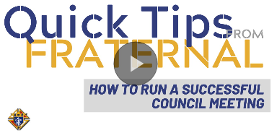
3. Running Successful Meetings
Watch this video on how to run a successful council meeting
Why are “Good” meetings so important?
Grand Knight – Roles & Responsibilities
Officers vs. General Meetings
New meeting guidelines from Supreme
Before the meeting - Preparation
During the meeting – Effective Execution
After the meeting – Follow Up

Slide 18
3.1 Why are “Good” meetings so important?
Poorly run meetings have negative consequences
  Some people don’t come back (eventually they quit)
  Impacts morale, frustration builds, and very little gets done
Well run meetings have the opposite effect
  Meeting attendance (over time) improves
  People have fun, make friends and enjoy themselves
  People feel like it was a good use of their time (effective)

Slide 19

3.2 Grand Knight – Roles & Responsibilities
Facilitate – Don’t dominate
Have fun – Meetings should be enjoyable
Informative – Communicate “only” valuable information
Interesting – Not boring
Moving – Don’t let things get off track
Goal = Have your members leave the meeting saying…
“Wow! That was a great meeting!”
Note: Men don’t join the Knights to attend meetings and pay dues.

Slide 20
3.3 Officers Meetings vs. General Meetings
Factor | Officers Mtg | General Mtg
Attendance | Mainly Officers & Directors (But everyone should feel welcome to attend) | Entire council
Purpose | Mainly administration (forms, council issues, plan for council meeting) Cover details that don’t interest members. | Summary review of information to: Keep members informed Get members excited & engaged
Formality | Less formal, but serious work gets done | More formal, guards, motions, minutes, etc…
New Items | New ideas and programs get discussed in detail and agreed upon. | Summary of new ideas and programs is presented to the general membership.
General Meeting Agenda | The detailed General meeting agenda is worked out here. Presenters then need to prepare a “high-level” report. | Well thought-out “High-level” reports are presented (minimizing detailed discussion)
Officer / Director changes | These are discussed here in detail | These are presented here Officer changes are voted upon Director changes are announced
Agenda | Follow The Guidelines for Council Meetings Agenda = Appendix F | Follow The Guidelines for Council Meetings Agenda = Appendix B

Slide 21
3.4 New Guidelines from Supreme
Topics covered include…
Chamber Setup
Successful Council Meeting Elements
In-Person vs. Virtual Meetings
Successful Officers’ Meeting Elements
Parliamentary Procedures
Appendices (lots)
Resources:
Presentation Slides - PDF
Presentation Slides - PPT
The Guidelines for Council Meetings
Frequently Asked Questions

Slide 22
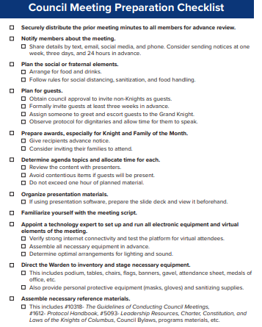
3.5 Before the meeting
Preparation
Review The Guidelines for Council Meetings
Plan the agenda
  Review previous meeting minutes
  ID topics to be carried forward (Old Business)
  ID new topics (New Business)
  Review Dan Remeika’s “Talking Points”
Walk through the Preparation checklist
  Make sure everything is covered

Slide 23
3.6 During the Meeting - Effective Execution
Start on time, every time! – Will help you end on time
Follow the agenda – Park new items for future discussions
Make a list of YOUR Action Items – for YOUR follow up
Assign responsibilities/tasks – For others to follow up
Confirm next steps
Don’t get bogged down
Use Robert’s Rules
Have your councils Advocate help control the meeting
DO NOT revisit issues/vote unless
  New data or information becomes available or…
  Circumstances have changes

Slide 24

3.7 After the meeting – Follow up
Publish meeting minutes – As soon as possible
Follow up – Ensure all tasks and assignments are done
Include your action items – You need to set the example for others to follow

Slide 25

4 – Youth Protection
Training Requirements
  Who needs training?
  What training is needed
How to Sign up for training
Armatus Website – Email to Compliance Process
Youth Certification Reporting
Frequently Asked Questions (FAQs)

Slide 26
4.1 Training Requirements
Position | Meet Sam | Duty to Report | KofC Policies | Background Check
Grand Knight | Required | Required | Required
Program Director | Required | Required | Required
Community Director | Required | Required | Required | Required
Family Director | Required | Required | Required | Required
All councils must also comply with all Diocesan Youth Protection requirements. Contact your Diocesan Program Director of State Deputy Regional Representative (SDRR)to find out the requirements for your Diocese.

Slide 27
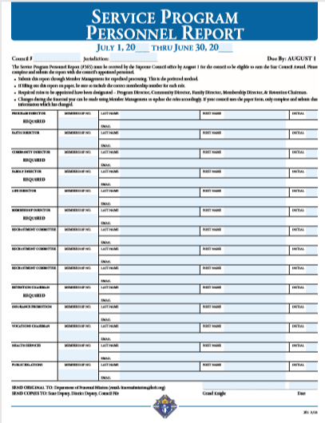
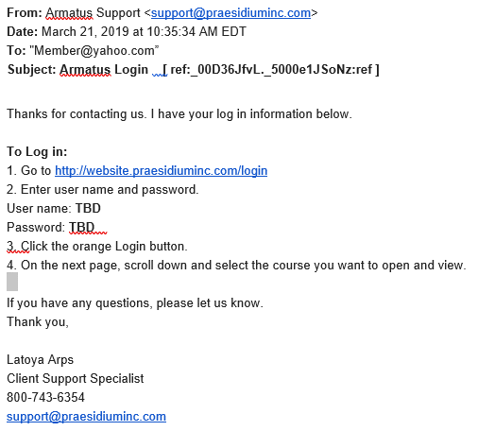
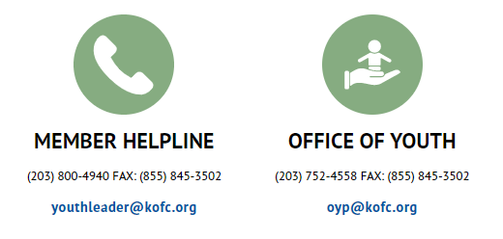
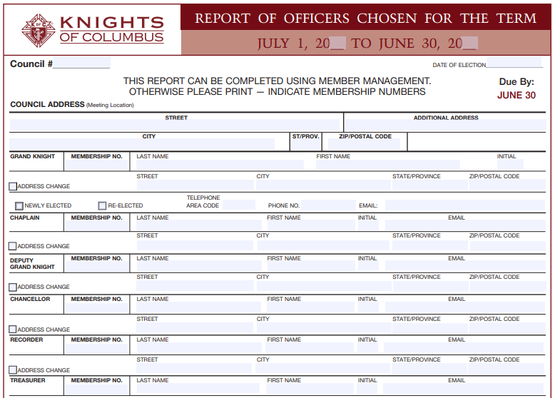

4.2 How to Sign up for training
Council submits:
Form 185
Form 365
Supreme notifies Armatus / Praesidium
Praesidium sends e-mail to members for training
Email Addresses are required on forms 185 & 365.
Email addresses must be personal (cannot use MIKOFC.ORG email addresses)

Slide 28
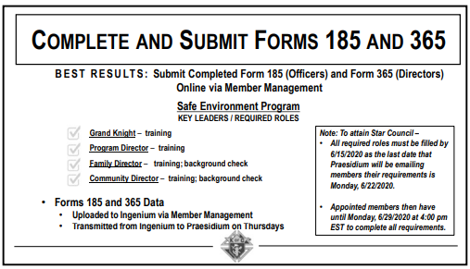

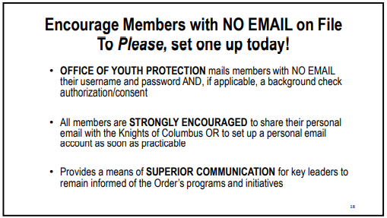
Email Addresses are required on forms 185 & 365.
Email addresses must be personal (cannot use MIKOFC.ORG email addresses)

Slide 29

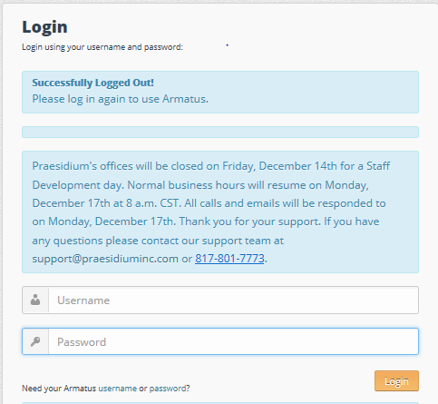
4.3a Armatus Site – Step 1

Slide 30

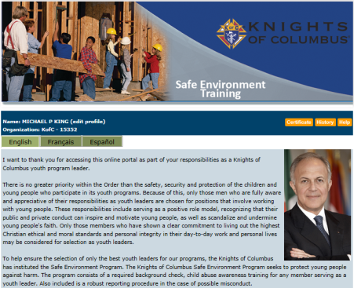
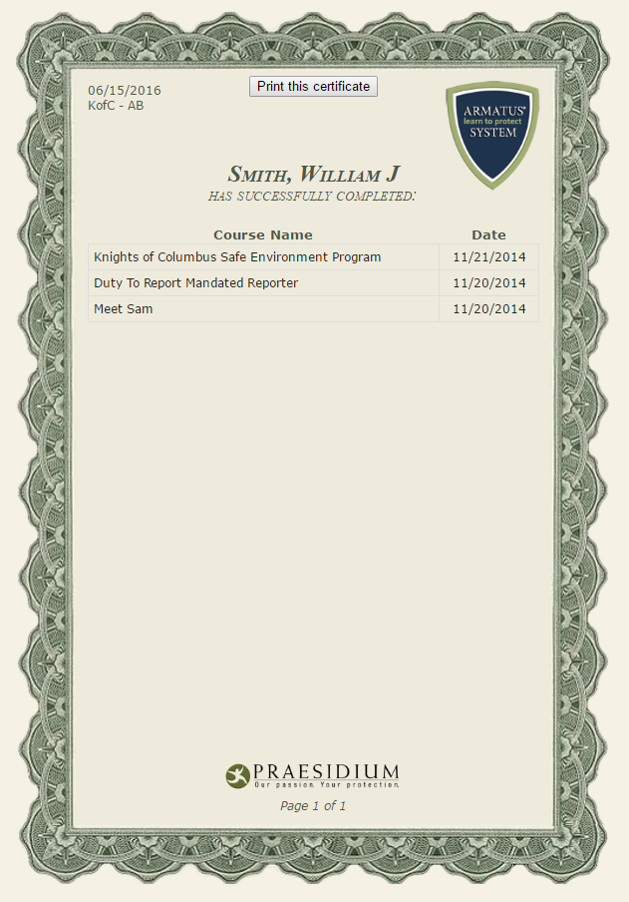
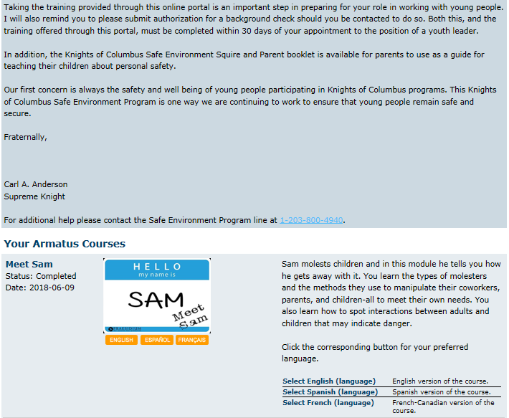

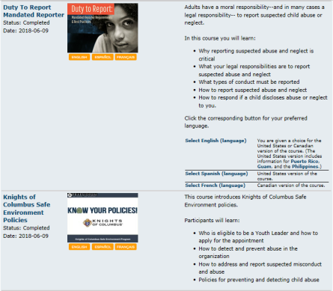
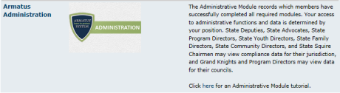
4.3b Armatus Site – Step 2
Take your 3 classes
Meet Sam
Duty to Report
KofC Safe Environment Policies
Armatus Administration (PDs & GKs only)

Slide 31

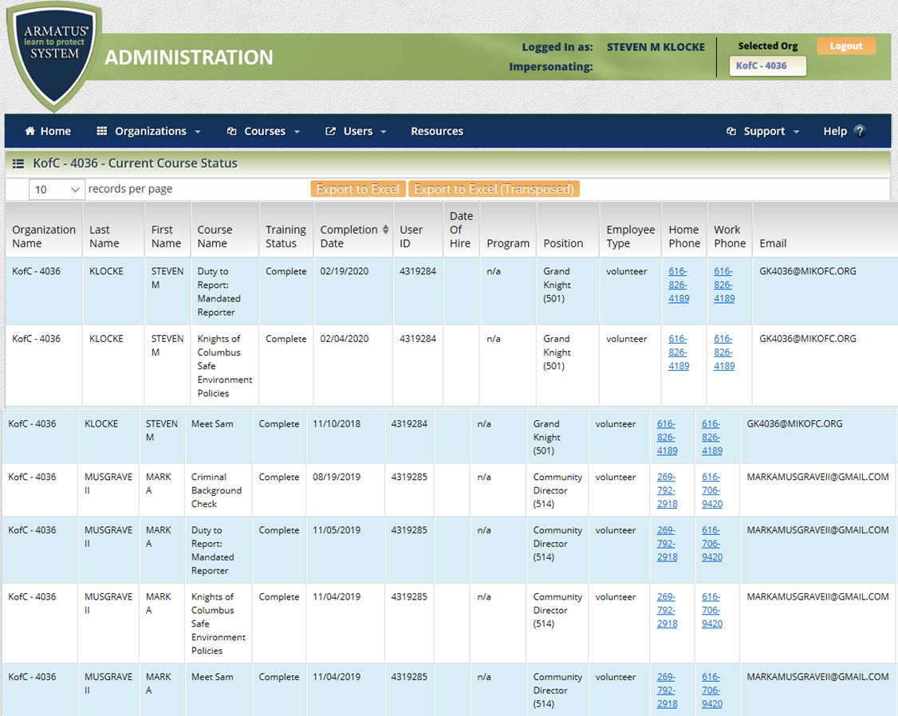
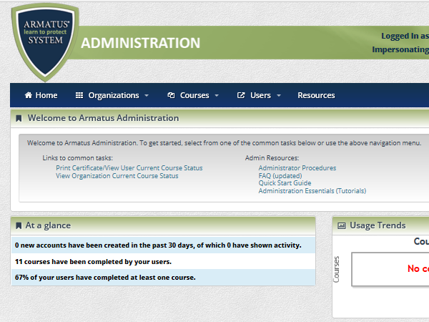
4.4a Youth Certification Reporting - Armatus

Slide 32
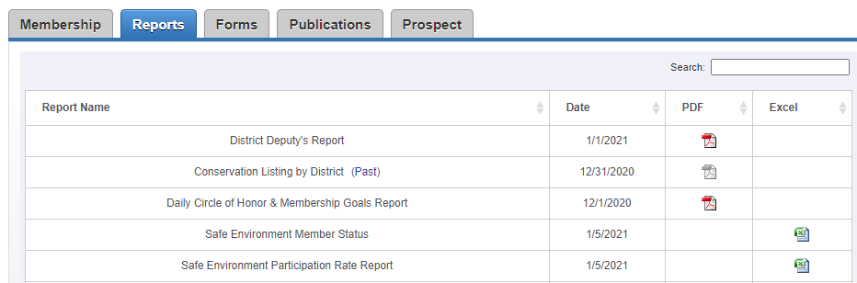
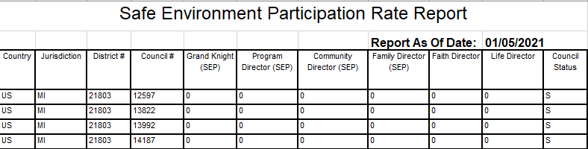
4.4b Youth Certification Reporting – Officers Online
Officers’ Online Steps
Go to: www.kofc.org
Sign in
Click on Reports
Member Status Report
Participation Rate Report
Available to:
Grand Knights
District Deputies
Financial Secretaries ???

Slide 33
4.5 Frequently Asked Questions (FAQs)
How do I complete the required Background Check?
  Option 1 – You will receive a separate email containing a link to complete your Background Investigation
  Option 2 – Get the BGC Consent for US Members PDF form, print page 2, scan & email it to OYP@kofc.org
I don’t have an Email address. How do I take the training?
  Option 1 – Get an Email address… It’s free. Click here to see how.
  Option 2 – Use a family members email account (Wife, child, parent)
I’m terrible at using a computer. Can I take the courses any other way?
  Option 1 – Have another council member sit with you to help you navigate the computer
  Option 2 – Call Supreme (203-800-4940), they will send you a book in the US mail.
I think I’m compliant but Supreme Reports say I’m not
  Check out the reports, print your certificate, call Supreme (203-800-4940)
  If the above doesn’t resolve the issue, contact your District Deputy & he will resolve the issue.

Slide 34
Grand Knight
Final Comment
Always keep in mind what is important…
Is your council doing great things for your Parish(es)?
Are your members having fun doing charitable programs?
Are your members becoming better husbands, fathers, Catholics and men?
Are you attracting new members because they see the good works that you do?

